Slide 1

Sales Dataset Analytics – Advanced Excel Project
By
S.Jayanthar
DADS July Batch

Slide 2
Project Overview & Objectives
Project Objective: To analyse sales data to identify trends, understand sales performance and provide actionable insights.
Goals:
Analyze sales trends over time.
Identify high-performing products and sales channels.
Determine the impact of returns and discounts.
Create a dashboard with key metrics

Slide 3
Data Description & Preparations
Dataset Overview: Dataset have 9995 rows & columns with headings of order ID, sales ID, product type, sales, discount, profit etc.
Data Cleaning Process:
Bolding Headers and freeze top rows
Remove duplicates and blank rows
Date format correction and addition of adjusted sales
Adding currency symbol to profit and proper alignment

Slide 4
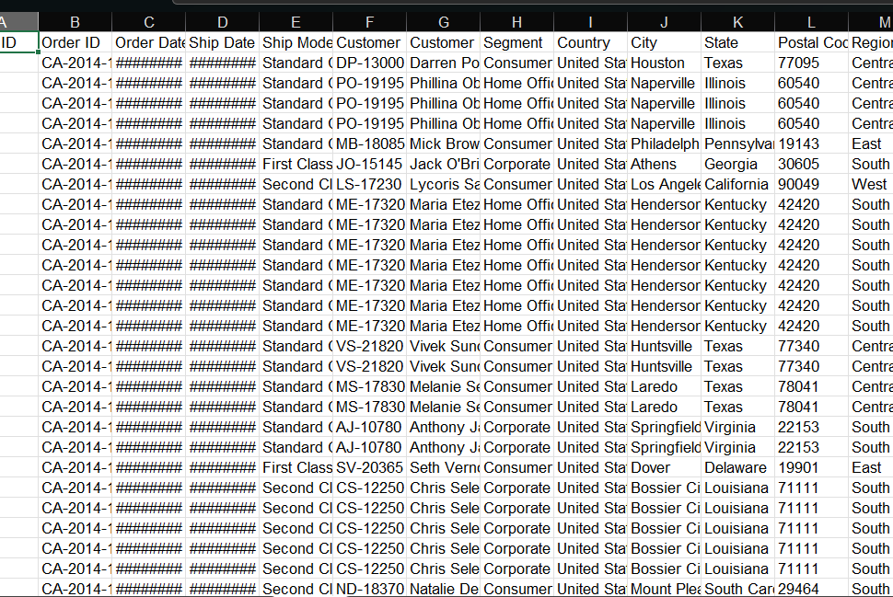
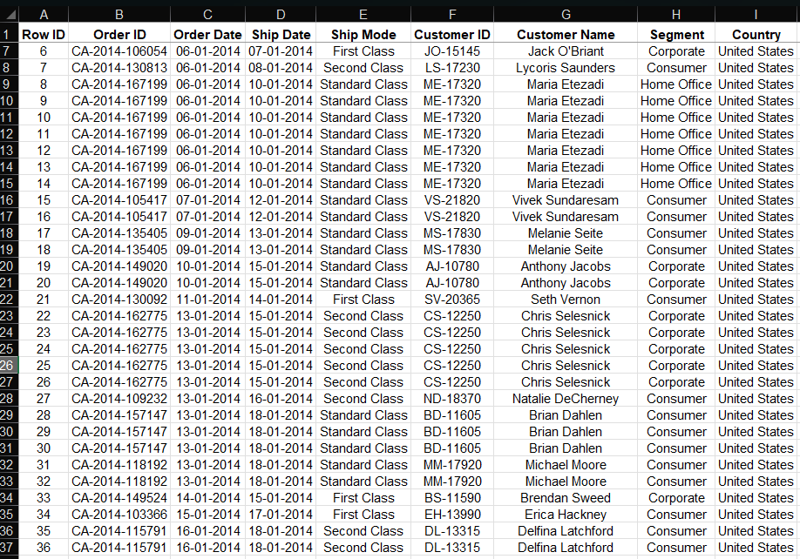
Visuals of Data description & Preparations

Slide 5
Key Metrics Calculation & Data Analysis
Total sales formula : =sum(sales range)
Adjusted Sales formula: =ROUND(sales*(1-discount),2)
Total Adjusted Sales formula: =sum(range)
Discount Rate formula: =sum(range)
Average Order Per Value formula: =average(sales/adjusted sales)

Slide 6
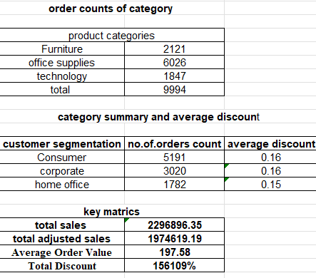
Visuals of Key Metrics Calculation & Data Analysis

Slide 7
Pivot Table & Pivot Charts
Pivot Table Summary: Pivot Table is used to analyse large datasets quickly with the help of both numerical & categorical data's.
Pivot Chart Visualization: Pivot Chart is used to visualize the data in charts & graphs to represent and understand in easier manner to others.

Slide 8
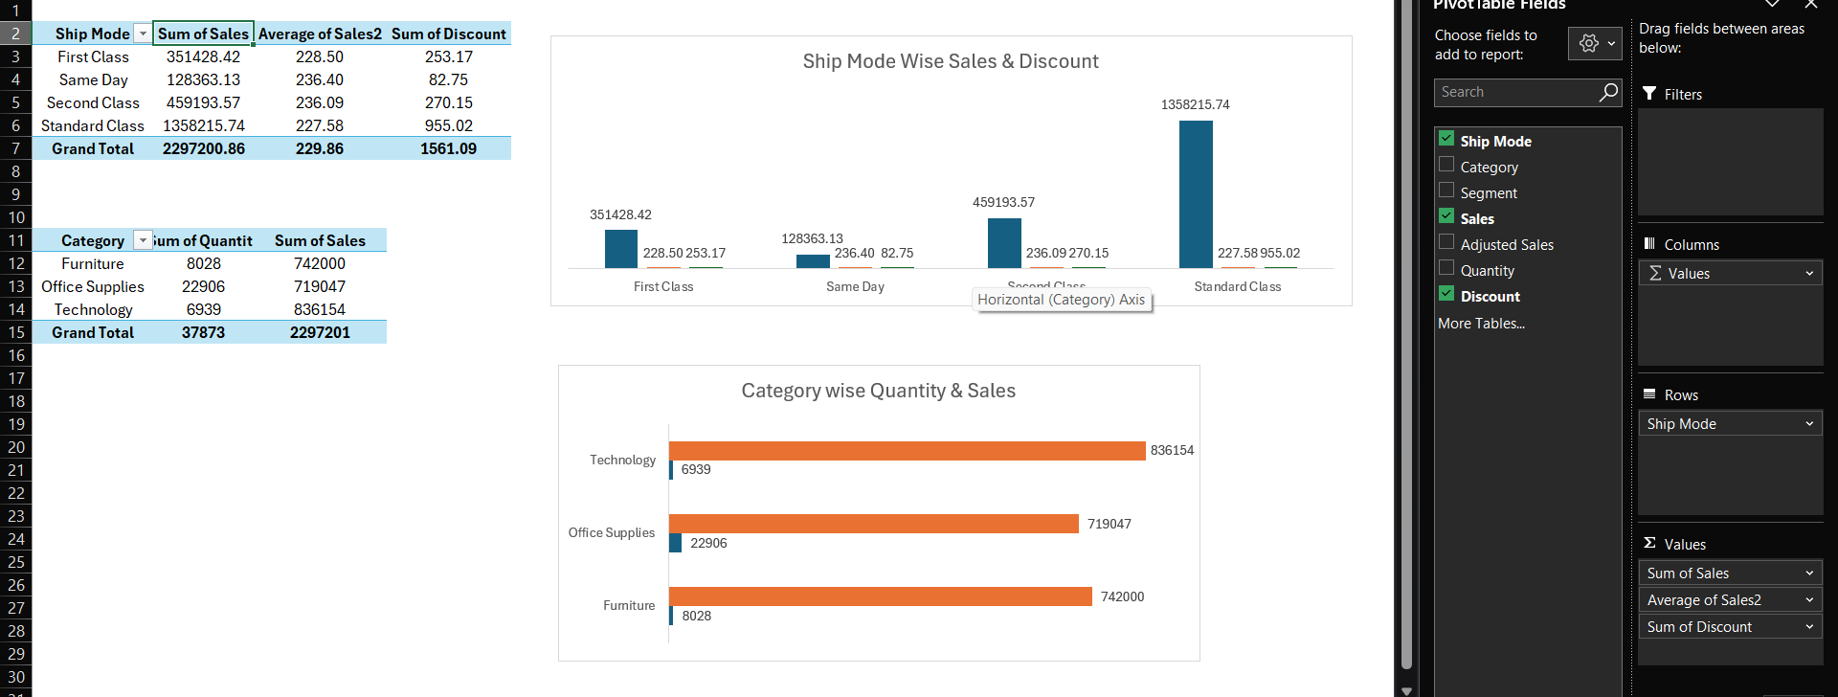
Visuals of Pivot Table & Pivot Charts

Slide 9
Dashboard Overview
Dashboard Design: Dashboard design is used to display the final outcome of the dataset to represent the findings, insights and recommendations from the dataset.
KPIs: In this dataset we can see sales, discounts, average per order value & top performing product categories as the key performance indicators.

Slide 10
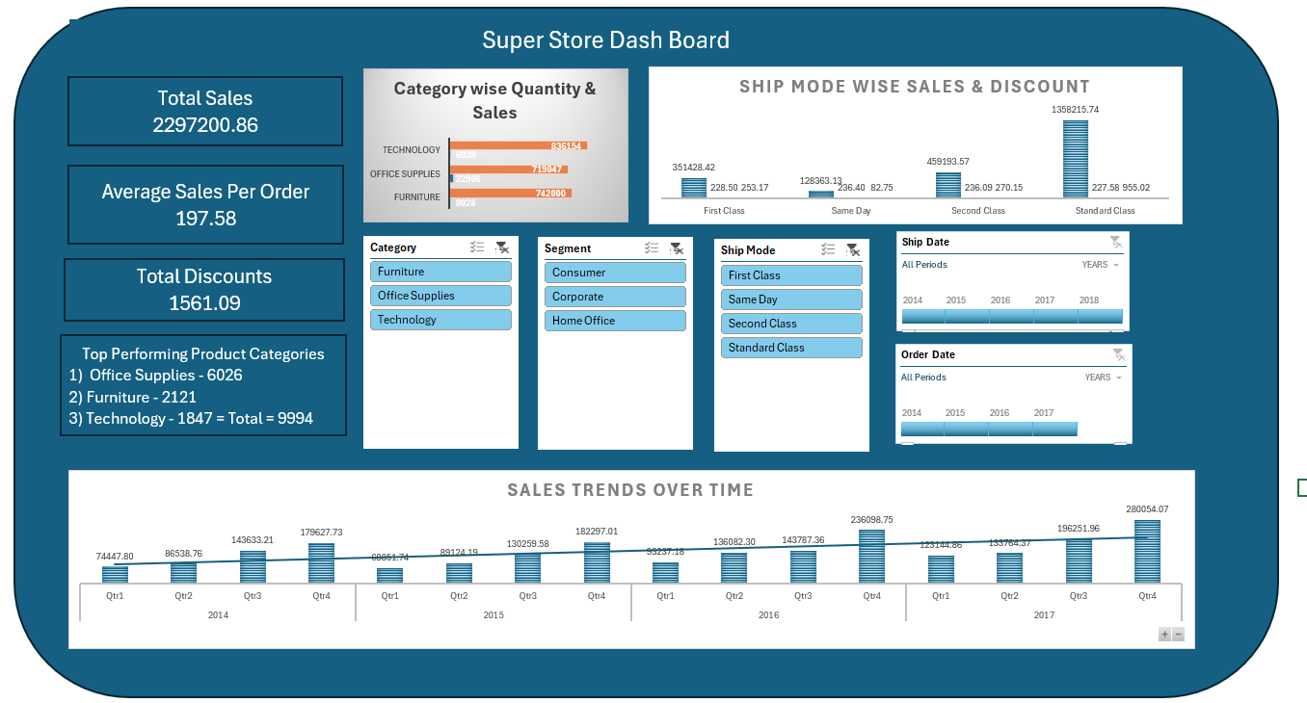
Visuals of Dashboard Overview

Slide 11

What If Analysis & Goal Seek
What If Analysis: What if analysis is used to identify how the sales varies when they is hike or decrease of sales and discounts in the dataset.
Goal Seek: Goal seek is used to decide the no.of.units & quantity is used to achieve the assigned target in future.

Slide 12
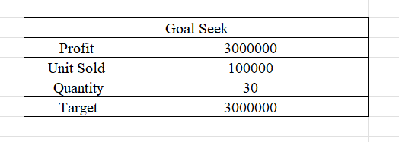
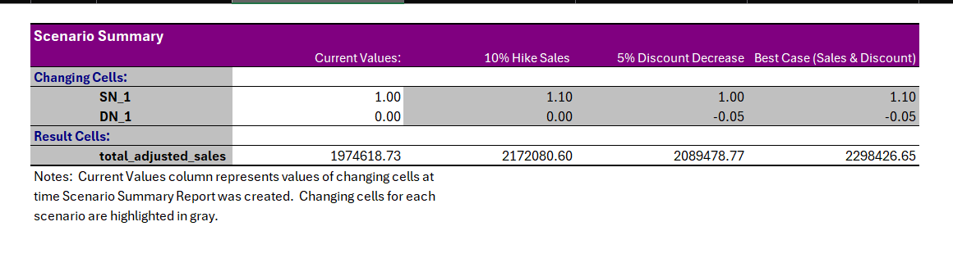
Visuals of What If Analysis & Goal Seek

Slide 13

Macros & Automation
Macros Recording: Macros recording is used to run the repetive task with the help of macros and without the involvement of manpower.
Automation Benefits: It saves time when there is huge dataset involved and makes the remaining time to work on another dataset or next level of data preparation.

Slide 14
Insights & Recommendations
Insights: Best performing product category is technology -8,36,158
Total sales – 22,97,200 , adjusted sales – 19,74,619
Recommendations:
They can provide referral code and coupon code for referring customers
They can provide the discounts on bulk orders, festival time orders & regular customer orders
They can collect feedback from the customers to improve the quality of their shops and products in future

Slide 15

Conclusions
Focus on weaker Technology category and re-evaluate Furniture performance.
The analysis show that Business should optimize shipping strategies and strengthen presence in South Region comparing to other regions.
Focusing on reducing returns and improving weak categories like Furniture will help sustain growth and boost profitability to earn further profit.

